Slide 1

Frito Lay Data Investigation
Garrett Shankel – gshankel@mail.smu.edu

Slide 2

Agenda
Overview of Data Provided
Attrition Investigation
Salary Investigation

Slide 3


Questions of Interest
Identify the three most influential factors in employee attrition rates
Identify the three most influential factors in employee salaries
Notes:
Our team was tasked with finding and describing the three most influential factors in employee attrition rates and the three most influential factors in employee salaries. In order to accomplish this we were given a data set provided by the Frito Lay team that had a number of descriptors for employees and what their salaries were and whether or not they had left their job. This data set was the basis of our investigation.

Slide 4
Dataset Cleaning
CaseStudy2-data.csv
The data set provided was comprised of 36 different variables. Each of which was applied to an observation on one employee.
Three of the variables were removed from the analysis since each of them had the same values for every employee
No cleaning was required beyond removal.

Slide 5
Attrition Investigation
Correlation
First, we began with the correlation values for every variable when compared to attrition
The four variables on the right had noticeably high correlation when compared to the other variables.
Over Time – 0.27
Job Role – 0.2
Marital Status – 0.18
Business Travel – 0.084

Slide 6
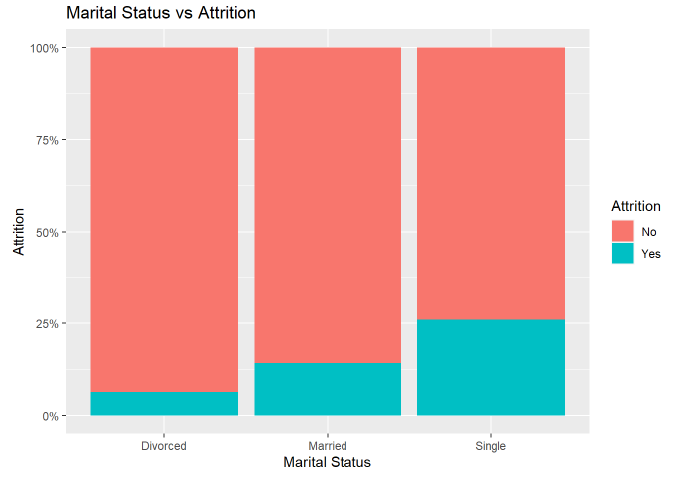
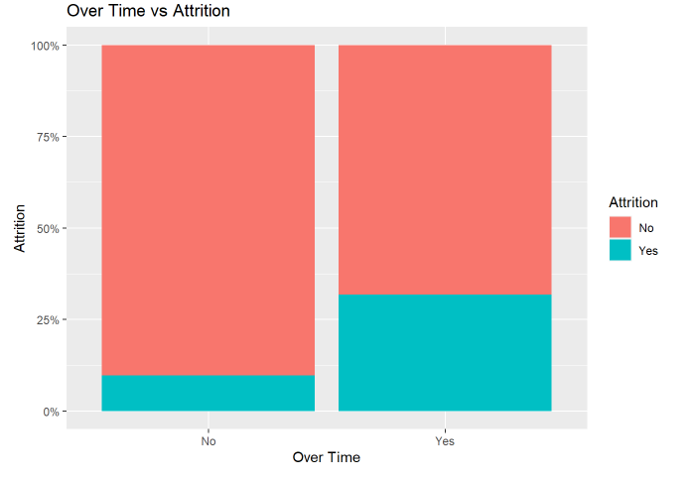
Attrition Investigation
Correlation - Graphical
Notes:
Here are two graphs from the four variables previously mentioned concerning attritition. As can be seen visually, Marital status has a clear relationship to attrition as does overtime… keep talking about these

Slide 7
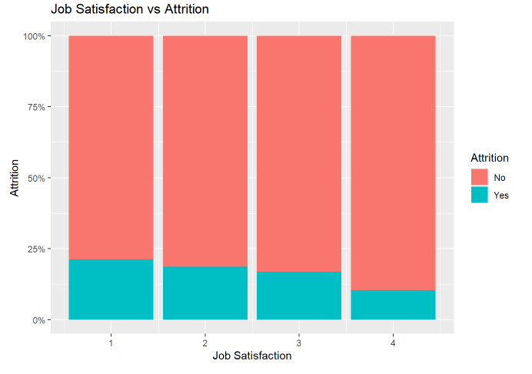
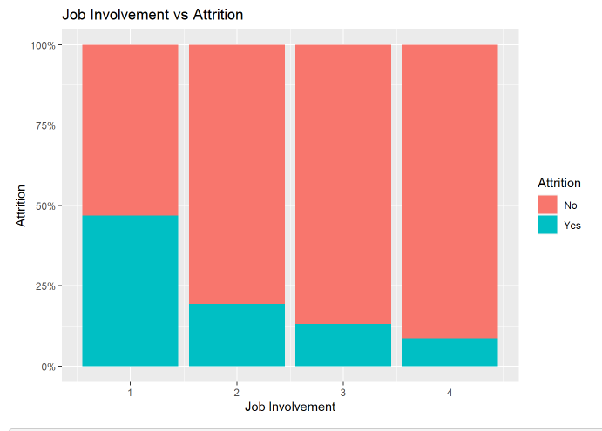
Attrition Investigation
Graphical Approach
Notes:
Corellation is a good start, but lets try a common sense approach by visualizing the data for some of the categories that would logically appear to lead to high attrition

Slide 8

Attrition Investigation
Regression
Finally, to solidify our results we built a regression model of the data set and pulled the most significant values from the model.
Over Time, Job Involvement, Job Satisfaction.
Notes:
As was seen graphically these variables do appear to be strongly related to attrition

Slide 9
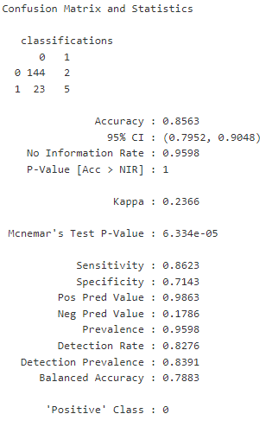
Attrition KNN Model
KNN Model
Next, we built a KNN model to classify attrition based off of OverTime, JobInvolvement, and JobSatisfaction.

Slide 10
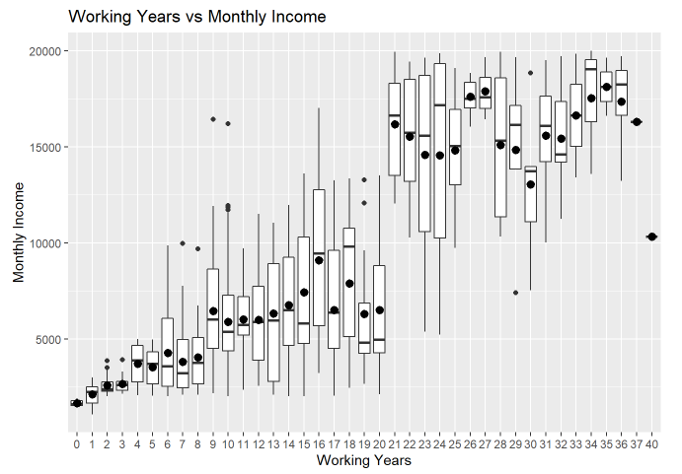
Salary Investigation
Graphical
Using similar methods as were used for Attrition we narrowed down three variables to help predict Salary.
Job Involvement
Job Role
Working Years

Slide 11
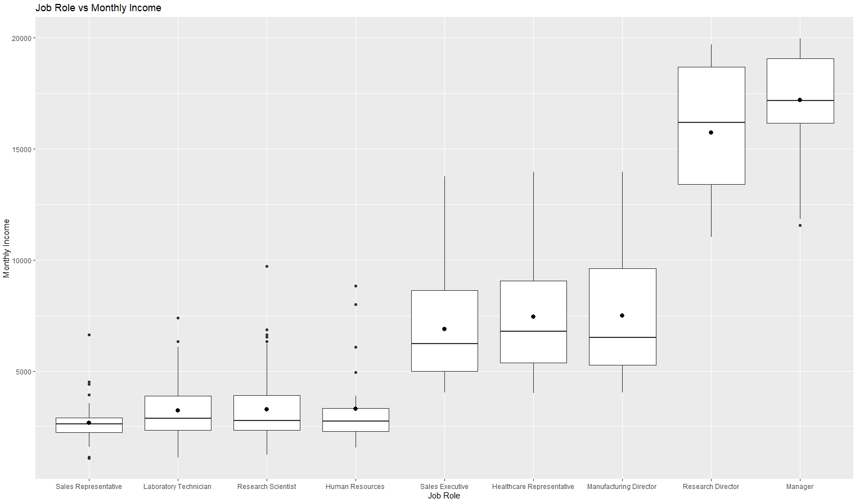
Salary Investigation

Slide 12
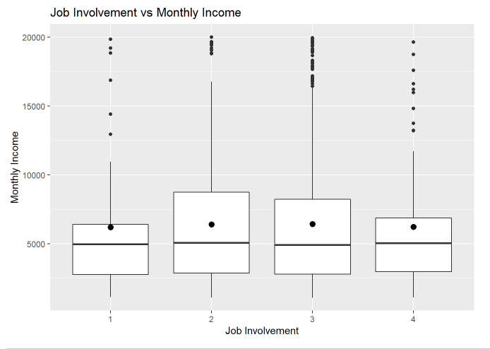
Salary Investigation

Slide 13

Attrition KNN Model
KNN Model
Next, we built a KNN model to classify Salary based off of Job Involvement, Job Role, and Working Years
This model resulted in an RMSE of $2140.59 meaning we could predict salary within $2140.59

Slide 14
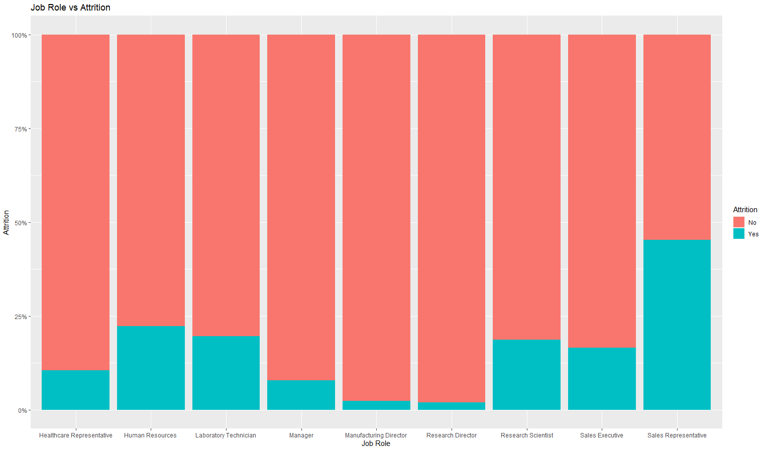
Sales Representative

Slide 15
Sales Representative
Attrition Statistics
The attrition rate for the entire data set is ~ 16%. The attrition rate for Sales Representatives is ~ 44%
The over time rate for the entire dataset is ~29%. The over time rate for sales reps is ~34%.
The average job satisfaction for the entire data set is 2.709. The average job satisfaction for sales reps is 2.689
The average job involvement for the entire data set is 2.723. The average job involvement for sales reps is 2.604

Slide 16


THANK YOU
Garrett Shankel
gshankel@mail.smu.edu

